Slide 1
Indian Knowledge System-
An Introduction
Module-1

Slide 2
Do we need Indian Knowledge System?
IKS
is not about merely knowing about some ancestral
(पॖत॑क)
knowledge.
It is about protecting revised wisdom (ऺॠषख़ोधत ৯ॊन), economic security and national pride.
India has a long surviving civilizational history to at least 5000-8000 year back.
There is an impression that all knowledge that we benefit from has originated from west. (This is not true)

Slide 3
Do we need Indian Knowledge System?
Indians were extraordinary in steel making until the 17th century. The Indian ‘wootz’ steel was used to manufacture what was famously known as ‘Damascus blades’.
Due to major changes in the educational system in India introduced about 200 years back, there was a rather abrupt (आक्िक) end to the process of knowledge transmission.

Slide 4
Importance of Ancient Knowledge
Ancient (ঋॊचॎन) knowledge is the accrued knowledge over several generations and preserved in formal and informal means.
Formal means include documented knowledge and informal means include several values and practices through oral traditions.
Ancient knowledge provides a head start to
society to march on the
highway of innovation and new knowledge creation.

Slide 5
Importance of Ancient Knowledge
Importance of Ancient Knowledge--
➢Identity- It defines the context for several aspects of the day to day living of every individual.
➢Culture- It is the manifestation (अोभव्यस्तत) of human intellectual achievement regarded collectively by society over time.
➢Received Wisdom- Innovation and new knowledge creation for the society.
➢Economic Value- Transforming knowledge into economic values for the benefit of the country.

Slide 6
Defining Indian Knowledge System
IKS is generic phrase that covers practically everting about India.
We have recorded history, abundant (ो रपॐर) culture, literature and social and community practices defining what Indian knowledge.
Knowledge assets available in India from the pre-historic times to the current day will all qualify to be part of the IKS.
The term IKS has three words in it:
➢Indian
➢Knowledge
➢System

Slide 7
Defining Indian Knowledge System
➢Indian- By this term, we mean the indigenous sources of knowledge generated by Indian society. The term ‘Indian’ points to the undivided Indian subcontinent (Akhanda Bharata).
➢Knowledge- It is obtained by the insights gained by personal experiences with life situations, facing problems and coming up with means of solving them. Knowledge may or may not be converted to a literary format. The tacit knowledge can be preserved and transmitted through an oral tradition without loss.
➢System- Means a structured methodology and a classification scheme to access the available corpus (कख़ह) of knowledge.

Slide 8
What did other countries called India(Bharat)
Ancient & Historical Names:
Bhāratavarsha (भारतवर्ष) – Used in Indian scriptures like the Mahabharata and Puranas.
Jambudvīpa (जम्बूद्वीप) – Found in ancient Hindu, Buddhist, and Jain texts, referring to the Indian subcontinent.
Āryāvarta (आर्यावर्त) – Mentioned in Sanskrit texts, meaning "Land of the Aryans."
Hindustan (ہندوستان) – Derived from Persian, commonly used during the Mughal era.
Bharatakhanda (भारतखण्ड) – Used in historical Indian texts for the region.

Slide 9
Names Used by Other Countries:
Greek: "Indía" (Ινδία) – Derived from the River Indus (Sindhu).
Persian: "Hind" (هند) – Also from Sindhu; used by Persians and later by Arabs.
Chinese: "Tianzhu" (天竺) – A name used in ancient Chinese texts(Land of Heaven )
Tibetan: "Gyagar" (རྒྱ་གར་) – Meaning "Land of the Dharma."
Arabic: "Al-Hind" (الهند) – Used by early Arab traders and scholars.
Latin: "India" – Used by the Romans and later Europeans.
Portuguese: "Índia" – Derived from Latin and Greek traditions.

Slide 10
The IKS Corpus- A Classification Framework
There are many ways to define and identify what constitutes IKS.
Ex:-
➢One approach to merely pick the important topics representatively of knowledge corpus such as Vedas, Yoga, Vastu, Silpa Sastras, Ayurveda, Buddhism and Jainism to define IKS.
➢Another approach is to select phrases such as Indian psychology, Indian arts, dance, architecture and put together related works into it to construct IKS.
➢NOTE:- These examples bring out the components of IKS.

Slide 11
The IKS Corpus- A Classification Framework
The usefulness of a classification framework depends on three factors: Completeness, Compactness and inter-connectedness.
➢ Completeness assures that all important components of IKS are included in the proposed framework.
➢ Compactness indicates the efficacy of the grouping of various topics in IKS in logical manner.
➢ Inter-connectedness brings logical relationship among the various sub- classifications.

Slide 12
The IKS Corpus- A Classification Framework
Closer scrutiny of IKS knowledge repository provides us following details:
➢The knowledge is available in both formal literary sources and informal literary source.
➢Among the literature sources, we can identify three categories
  Vedic and allied literature
  Other Dharmic Traditions
  Regional
➢The non literary sources is available through a rich set of oral traditions found throughout the country.

Slide 13
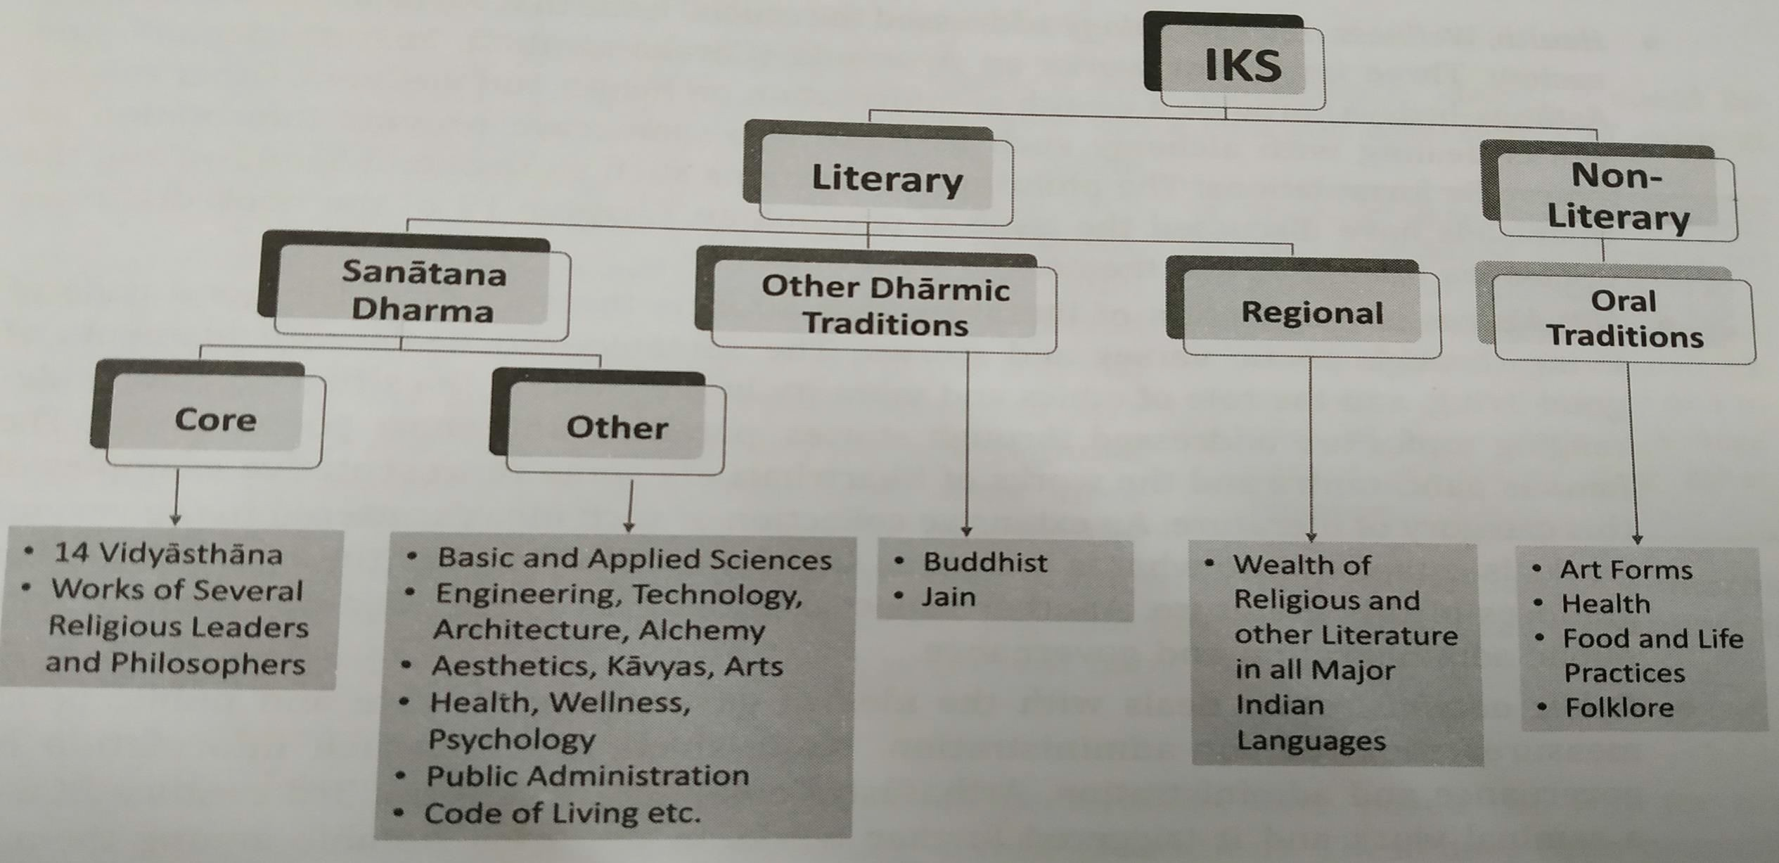
The IKS Corpus- A Classification Framework

Slide 14
Sanatana Dharma- Core Literature
➢This comprises a vast repository of knowledge starting with the Vedas, Known as Sruti.
➢Although the vedic corpus is oral in nature and still transmitted using oral methods.
➢The Vedas are considered foundational by the indian society.
https://youtu.be/HFfzrfufOCw?si=EsYSsjvT5isZn7NR

Slide 15
Sanatana Dharma- Other Literature
➢The other literature consists of works that addressed key issues of day to day life such as health, wellness, science, engineering, technology that aided societal progress of development and art forms.
➢This category covers several areas:
Basic and Applied Science( Maths, Astronomy, Plant Science)
Engineering, Technology & Architecture ( Metalworking, Shilpbuilding, Bams Perfumes, dyes, town planning, architecture)

Slide 16
Health, Wellness, Psychology ( Ayurveda (Caraka-samhita, Susruta – samhita, Astanga – hrdaya, rasartna samuccaya)
Niti – sastras ( Collection of literature that informs the society of the good code and living and the role of ethics and morality of life. Samanya – niti (good living and the role of ethics and morality of life (Panchatantra, subhasitas))
Public Administration( Manu – smrti, arthasastra, niti – sara )

Slide 17
Other Dharmic Traditions
➢Other dharmic traditions have stayed out of the Vedic framework but have immensely contributed to IKS in the religious, Philosophical and other domains.
➢Two of them, the Buddhist and the Jain literature are note worthy and they have contributed right from 500 BCE to IKS.

Slide 18
Regional Literature
➢The separation of regional language in this figure is only convenience.
➢Ideally, it could be included under sanatana dharma.
➢Indian constitution has listed 22 languages of the country, in each of these languages, there is a huge corpus of religious, philosophical and other literature.
➢Ex:- Tamil literature has several contributions in the Sangam Period.

Slide 19
Oral Traditions
➢The diversity of cultural practices and regional preferences have paved the way for oral traditions to preserve and transmit knowledge across generations.
➢These have been primarily in the form of folklore artistic endeavors, skillful jobs, foods and life practices and health.
➢Sanskrit has been dominant language for transacting knowledge for a long time in india.

Slide 20
Chaturdaśa-Vidyāsthāna
(चतॏद१ष-शशद्यॊमथॊन):
➢A classification framework for the sanatana-dharama
➢In this framework, the literature is systematically organized under 14 major divisions.
➢The components of the 14 part knowledge contain the four vedas (and their upa-vedas), the six vedangas, puranas, the Dharma- sastras, Nyaya.

Slide 21
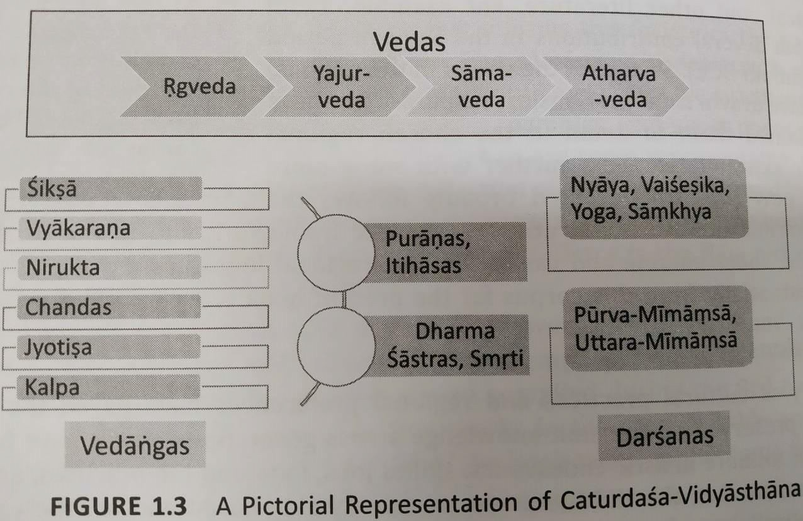
Chaturdaśa-Vidyāsthāna
(चतॏद१ष-शशद्यॊमथॊन):

Slide 22
Vedas
➢The Vedas are the primordial source of knowledge in the scheme of the Sanatan-dharma literature.
➢They are also known as Sruti.
➢Vedas provides the overall defining framework for living.
➢The upa-vedas are typically associated with the vedas on account of the material being found in the respective Vedas.

Slide 23
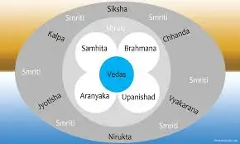
Vedangas
➢To benefits fully from the Vedas some complementary tools and skills are required.
➢These helps to understand the exact meaning an intent of what is presented in the Vedas and follow them based on specific instructions provided.
➢These are collectively referred to as Vedangas.

Slide 24
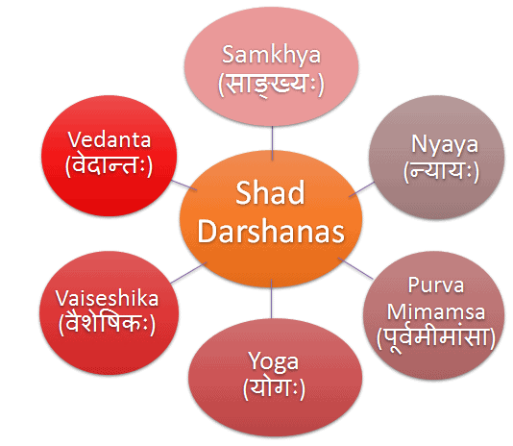
Darasanas
➢It is a natural quest for everyone to understand three forces that operate and intract with one another: an individual (Jiva), the Universe (Jagat), and a larger force governing the other two (variously referred to as Isvara, Brahman etc.)
➢Darsana essentially means a philosophical thought or view.
➢There are six schools of philosophy in the sanatan-dharma literature.
The Shad-Darsanas (the six schools of philosophy) or the Shat-Sastras are: the NYAYA, founded by Gautama Rishi, the VAISESHIKA by Kanada Rishi, the SANKHYA by Kapila Muni, the YOGA by Patanjali Maharshi, the PURVA MIMAMSA by Jaimini, and the UTTARA MIMAMSA or VEDANTA by Vyasa.

Slide 25
Puranas and Itihasas
➢Puranas contains a rich repository of ideas that seek to explain various aspects of the Vedic thoughts using detailed stories and anecdotes
➢They present several socio-cultural ideas and practices of living.
➢The stories in the purans related to per-historic events.
➢Itihasas, related to historical events that have taken place which can be associated with specific timelines.
➢As we know, Mahabharata and Ramayana are two well known itihasas.

Slide 26
Dharma-sastras and Smrtis
➢A guide to lead a dharmic life based on the principles of the Veda is required.
➢The dharmic principles engrained in the Vedic corpus are presented in multiple formats in our knowledge traditions.
➢Smrtis are rule books with specific operating guidelines of how to put the dharmic principles into action and what are the consequences of not doing so.

Slide 27
Historicity of IKS
➢Dating of the Indian Literature is a major challenge for today’s researchers.
➢Other related challenge is that most of the indian knowledge repositories in the BCE (Before Common Era or Before Current Era or Before Christian Era) were oral.
➢A useful source of data is to fix the Indian knowledge is the astronomical references found in the texts.

Slide 28
Before 3000 BCE
➢This era is categorized as the dark edge for western civilization since no evidence of any organized knowledge (either oral or written) is available.
➢Earlier estimates of time periods for Vedas, puranas and the Itihasas prove it be erroneous as new evidence and methods to date the knowledge becomes available.

Slide 29
3000 BCE to 500 CE
➢This period roughly starts with the beginning of recoreded human history as per the western context and extending as far as 500CE.
➢In an oral tradition, the entire knowledge is to be committed to one’s memory.
➢Therefore, it needs to be concise, and specific.

Slide 30
500 CE to 1800 CE
➢During this era, Indians have significant strides in the area of mathematics, astronomy, philosophy, spirituality.
➢Several contributions have also been made in other areas such as alchemy, metalworking etc.

Slide 31
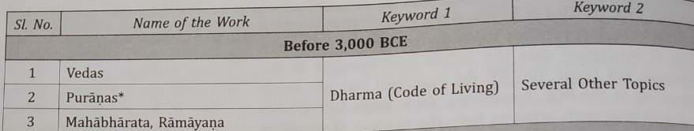
A Sample list of the IKS Repository

Slide 32
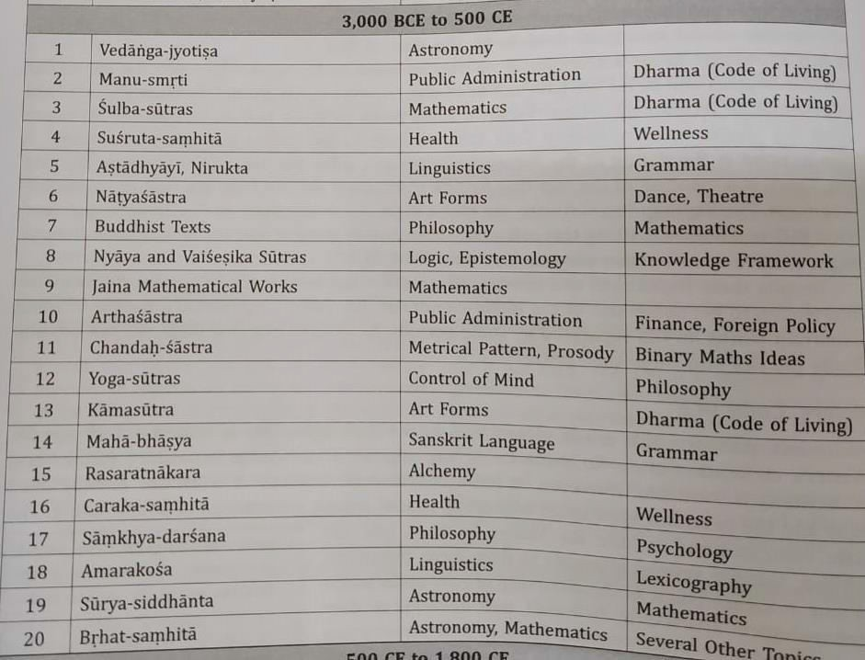
A Sample list of the IKS Repository

Slide 33
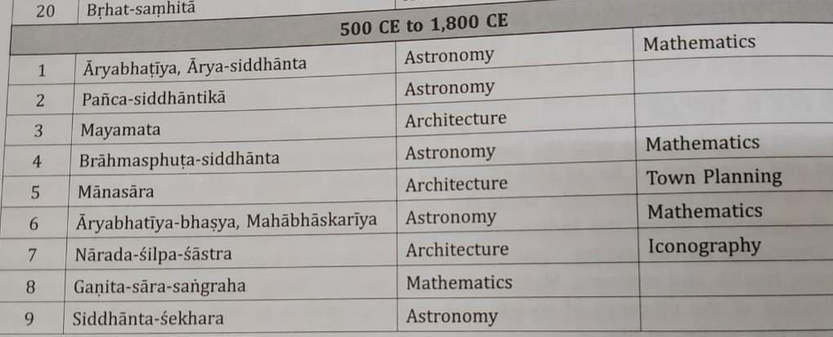
A Sample list of the IKS Repository

Slide 34
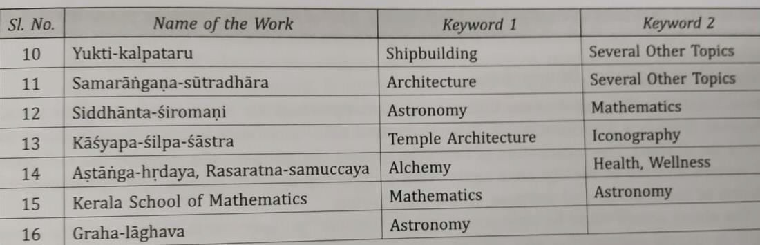
A Sample list of the IKS Repository

Slide 35
Some Unique aspects of IKS
Nuances (बारीकिय )ों of an Oral Tradition:
✓IKS is by and large oral tradition. If knowledge needs to be transmitted orally, it requires a few things.
✓In IKS a single work can provide simultaneously ideas on three streams: Spiritual, Religious and Secular.
✓A large number of works in IKS are in verses set to a metrical (measurement) structure irrespective of whether the subject matter is literature, mathematics, or engineering.
✓Two important dimensions of oral traditions are:
Religious Vs Material Dimension Spiritual Vs Material Dimension

Slide 36
VEDAS
The word Vedas is generally derived from the Sanskrit root vid(to know).
The word Veda can be derived from five verbal roots, these means:
✓To exist
✓To discriminate
✓To obtain
✓To know
✓To make

Slide 37
VEDAS
Veda
is transmitted orally and preserved intact from time
immemorial.
Vedas have well-developed system of phonetics that has ensured its preservation.
Recognized by UNESCO as heritage.
It is well-known that the Vedas are the oldest surviving literary works in the whole world.

Slide 38
The four VEDAS
Ṛgveda
Yajurveda
Sāmaveda
Atharvaṇaveda
https://www.youtube.com/watch?v=S1-17TeZvV0

Slide 39
Ṛgveda
Ṛgveda is the oldest, largest and the main repository.
Ṛgveda should be studied by one who want to understand Indian Literature and spiritual culture.
Lofty
and interesting set of ideas found in Ṛgveda makes it
contextually relevant.

Slide 40
Yajurveda
Yajurveda mainly focus on Yajna and a list of various Yajnas are found in this Veda.
Yajurveda is in two major branches: Krsna (Black) -Yajurveda and Sukla (White) -Yajurveda.
Yajurveda include anatomy, metals, constellation, seasons, numbers and geometry, grains and yogic insights.

Slide 41
Sāmaveda
indicating ‘to please pacify or satisfy’, it refers to the singing of Rgveda mantras.
Sāmaveda has currently three branches: Kauthuma, Ranayaniya and Jaiminiya.
Sāmaveda is used to please the devatas by singing mantras after making the offering.
The
word Sāmaveda is derived form the Sanskrit word Sama

Slide 42
Atharvaṇaveda
Atharvaṇaveda has details on diseases and their cure.
Paryers for prosperity and peace in the Vedas invariably included all the living organism in the Universe, not just the mankind.

Slide 43
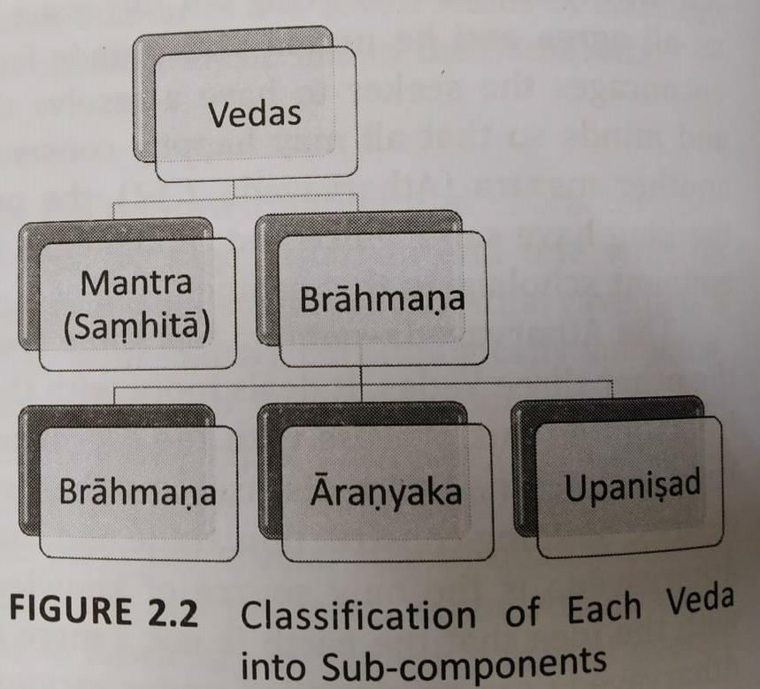
The Four Divisions of Each Veda

Slide 44
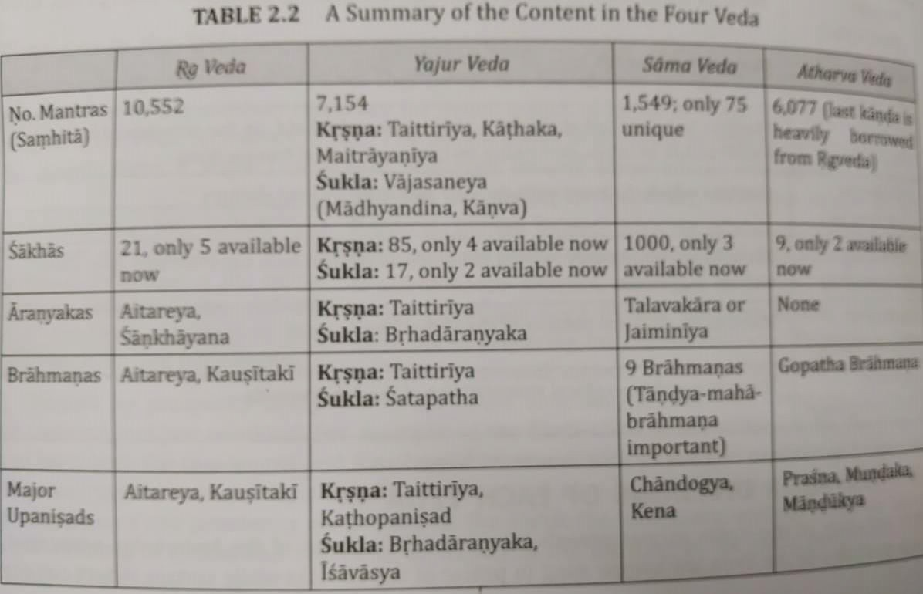
The Four Divisions of Each Veda

Slide 45
Samhita
Each Veda consists of Samhita, Brahmana, Aranyaka and Upanisads.
There were 25 women rishis who have composed hymns (poem of praise to God) in Rgveda.
Samhita constitutes the main portion of each Vedas and consist of a certain number of mantras presented in metrical form (poetic measure).

Slide 46
Brahmanas
Brahmanas does not relate to the modern word ‘Brahmin’, used to denote the caste.
These are a collection of knowledge mainly confined to the issue of ritual sand rites written in prose (written or spoken language).
Brahmanas prescribe the mantras from the Samhitas that need to be recited for the rituals.

Slide 47
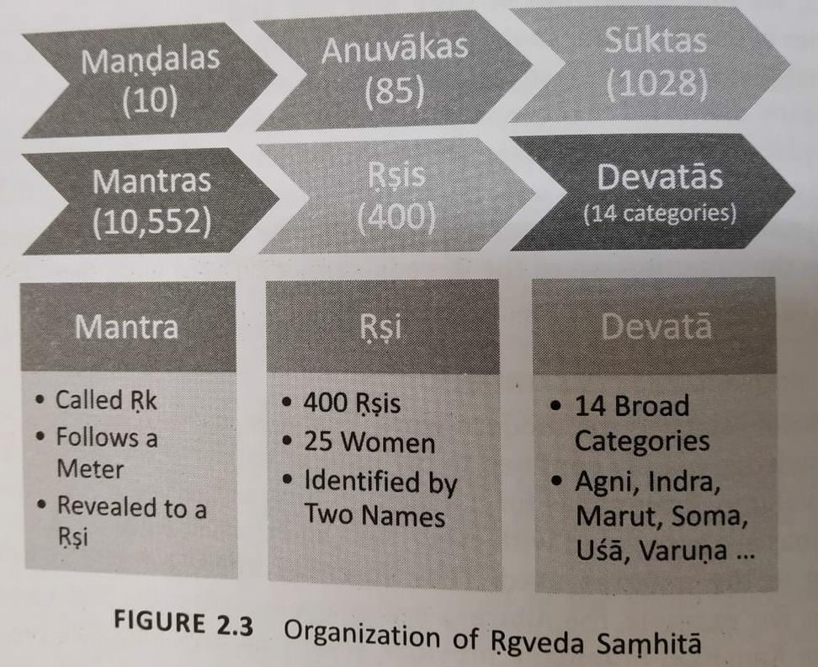
Brahmanas

Slide 48
Aranyakas
Aranyakas inquire into the philosophical aspect of a yajna.
Aranyakas are considered as bridge between brahmanas and Upanisads.
Aranyakas represent the Upasana kanda of the Vedas.

Slide 49
Upanisads
Upanisads
are philosophical treatises dealing with the ultimate
problems of life that every one of us confronts.
The word Upanisads means sitting near a Guru and receiving his wisdom through teaching-learning process.
Over 1180 Upanisads were supposed to have been part of the vedic corpus.
108 Upanisads in the four Vedas.

Slide 50
Upanisads
The loftiest thoughts of the vedic seers are found in Upanisads.
Upanisads pertains to the jnana-kanda of the vedas.
There are 10 principal upanisads.
The Maha-vakyas are found in the Upanisads.

Slide 51
Vedangas
Vedangas texts help us decipher the Vedic texts and know their practical applications; they have other values of practical applicability in other fields also.
There are six vedangas:
Siksa
Vyakarana
Chandas
Nirukta
Kalpa
Jyotisa

Slide 52
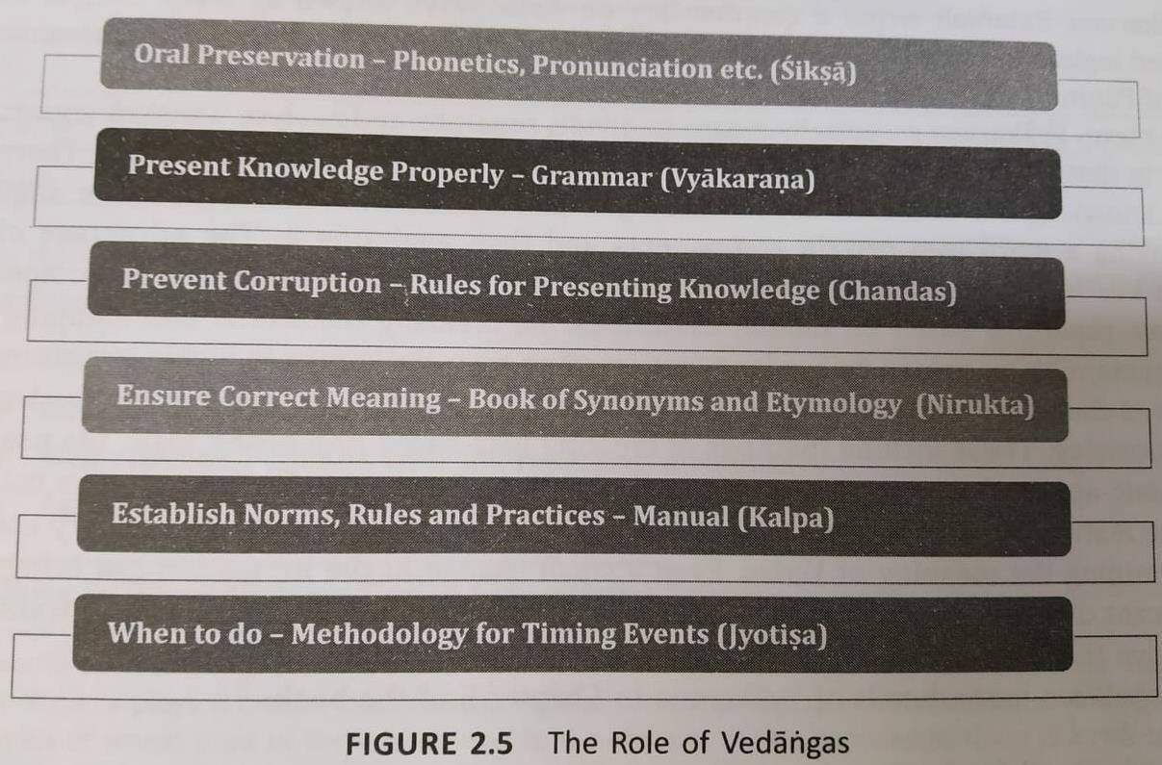
Vedangas

Slide 53
Siksa
The word Siksa means to acquire knowledge.
This has been described in Taittiriya Upanisad very briefly.
Siksa-sastra, therefore, is a systemic approach to the art and practice of phonetics.
It defines the characterstics of the basic units of the sound of the language known as varna.

Slide 54
Vyakarana
Grammar is the foundational aspect of any language.
TO understand the Vedic repository rules of grammar are required. Vyakarana is one the Vedangas that deals with this issue.
The
term Vyakarana essentially means to divide, separate and
analyze.

Slide 55
Nirukta
Nirukta is etymology, which is extracting the meaning of a word using linguistic theories and considering phonetic changes.
Nirukta is a collection of rarely used words in Vedas.
Nirukta is the most ancient work available on etymology anywhere in the world.

Slide 56
Chandas
Rhythm is the key aspect of an oral tradition be it Vedic mantras or music.
Chandas is the metre of poetic composition.
A Chandas (metre) can be viewed using three level hierarchy.
➢Syllables (aksara)
➢Padas
➢Metre

Slide 57
Kalpa
Kalpa focused on several operational aspects of the issues discussed in the Vedic Corpus.
Kalpa can be thought of as a guide or user manual that provides aspects of life including instructions and directions to lead all personal, family and social dimensions.
Following are the components of Kalpa:
➢Dharma-sutras
➢Grhya-sutras
➢Sulba-sutras
➢Srauta-sutras

Slide 58
Jyotisa
Like several other ancient civilizations, Indians were using the natural calendar which is based on keen observation of the sky with moon and stars.
This knowledge of the movement of stars and planetary bodies is called jyotisa.
Jyotisa-sastra is classified into vaidika (related to Vedas) and laukika (related to the world).

Slide 59
Philosophical Systems
The Philosophical systems provide a true worldview and a vision for life and helps us resolve the issues that we face in our life.
The
teaching of the Upanisads suggest that attainment of the
knowledge of Brahman is the highest goal of human life.

Slide 60
Indian Philosophical Systems- Development and Unique Features
The beginning of the Philosophical inquiry in India can be traced to the Vedic literature.
Unlike the western counterpart, the indian Philosophical thought closely intertwined with religious thought.
The ultimate goal of the human life is clearly spelt out and the path for attaining the same is also articulated in all the darsanas.
Two generic classes of philosophical systems could be thought about; Vedic schools of Philosophy and non-vedic schools (Jaina Philosophy, Buddhist Philosophy etc).

Slide 61
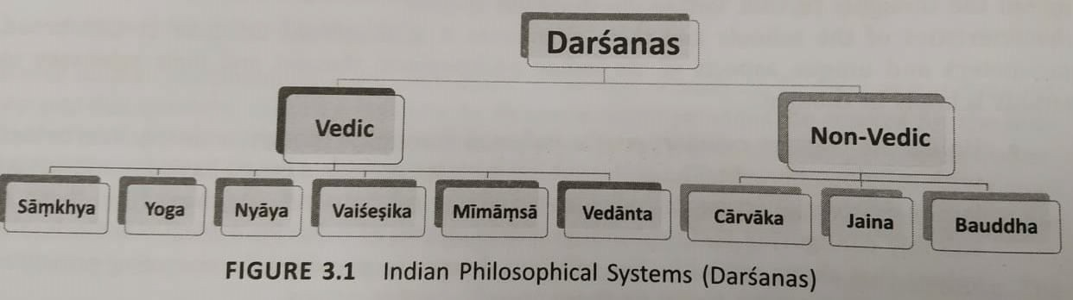
Indian Philosophical and Unique Features
Systems- Development

Slide 62
Vedic Schools of Philosophy
Vedic schools acknowledge the authority of the Vedic text whereas Non-Vedic schools do not.
The
context for philosophical discussion is three inter-related
concepts of God-Universe-Individuals.

Slide 63
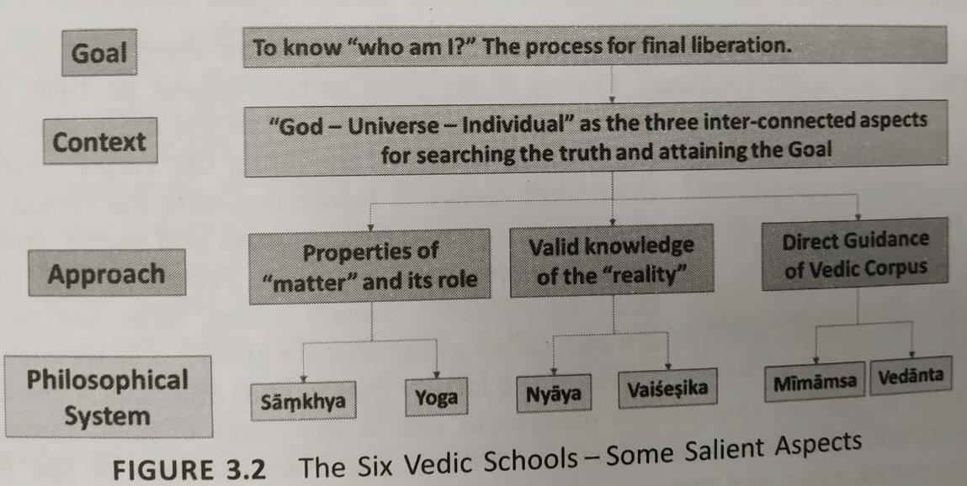
Vedic Schools of Philosophy

Slide 64
Samkhya and Yoga schools of Philosophy
Samkhya-darsana- Purusa and Prakrti
Yoga-darsana
Purusa and Prakrti- According to the Samkhya system, two basic elements constitute everything in this world,
  matter (Prakriti)
  sprit (Purusa).
Prakriti is made of three basic constituents namely
sattva,
rajas
tamas.

Slide 65
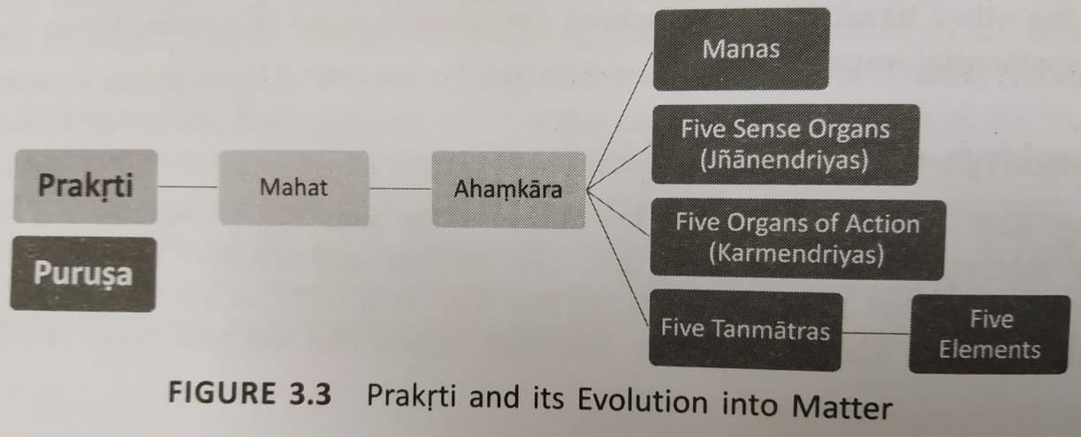
Purusa and Prakrti

Slide 66
Yoga-darsana
Yoga as a school of philosophy is said to have been founded by Patanjali through his Yoga-sutras.
According to Yoga Philosophy to attain liberation, an individual must focus on the physical, psychological and moral states of his being.

Slide 67
Yoga-darsana
Yoga provides a structured and practical eight-step process gradually reach a stage of complete cession of the activities of Citta.
Yoga can help an individual address the vexing problem of stress- induced lifestyle leading to health and wellness challenges that modern society is facing.

Slide 68
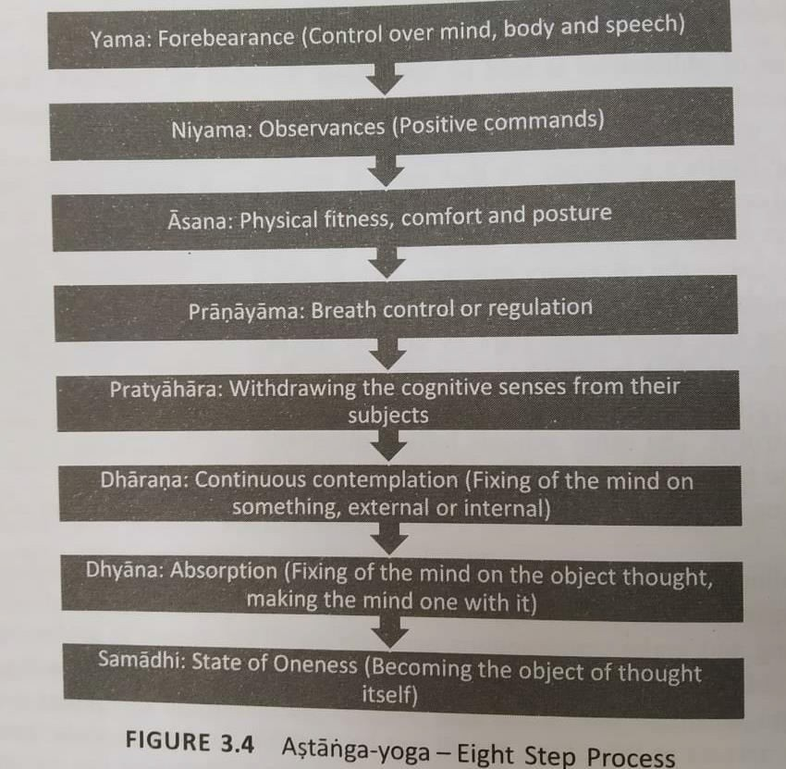
Yoga-darsana

Slide 69
Nyaya and Vaisesika schools of Philosophy
Nyaya deals with ‘ways of knowing the reality’ and Vaisesika with
‘objects in the reality that knowable’.
Nyaya and Vaisesika schools place a greater emphasis on obtaining the right knowledge for liberation.
The
word Vaisesika is derived from the word Visesa meaning
difference or unique attributes in a thing.
The Vaisesika school presents the knowable that form all the real entites in the universe using certain categories.

Slide 70
Nyaya and Vaisesika schools of Philosophy
Categories of Nyaya and Vaisesika schools of Philosophy:
  Nyaya-darsana
  Vaisesika-darsan

Slide 71
Taittirīya Upaniṣad
In the Taittirīya Upaniṣad, a significant father-son conversation occurs between the sage Varuṇa and his son Bhṛgu in the Bhṛguvallī, the third chapter of the Upaniṣad.
This dialogue is centered on the pursuit of Brahmavidyā (knowledge of the ultimate reality, Brahman).

Slide 72
Bhṛgu's Inquiry:
Bhṛgu approaches his father, Varuṇa, and asks to be taught about Brahman (the Supreme Reality).
Varuṇa's Initial Teaching:
Instead of directly explaining, Varuṇa gives Bhṛgu a framework for self-inquiry.

Slide 73
Anna-maya Brahman: Initially, he concludes that Brahman is food (annam), as it sustains life.
Prāṇa-maya Brahman: Upon further contemplation, he realizes that Brahman is prāṇa (vital force).
Mano-maya Brahman: He then sees Brahman as manas (mind), which governs perception and thought.
Vijñāna-maya Brahman: Later, he realizes that Brahman is vijñāna (intellect, higher wisdom).
Ānanda-maya Brahman: Finally, he reaches the highest realization—Brahman is ānanda (pure bliss).
He tells him that Brahman is that from which all beings are born, by which they live, and into which they dissolve

Slide 74
Purva-Mimamsa and Vedanta schools of Philosophy
This portion typically referred to as Karama Kanda of the Vedic Corpus.
Both the schools share common beliefs in several of the philosophical principles.
This includes the notation of atman, the existence of karma, rebirth and long seemingly endless cycle of birth-death.
The common goal of these two systems is to liberate the atman from the clutches of birth – death.
The major difference lies in the path to liberation.

Slide 75
Purva- Mimamsa Darsana
The
word Mimamsa conveys different meanings: reflection,
consideration, profound thoughts, investigation, examination and discussion.
In the context of Purva- Mimamsa schools Mimamsa Means reflection or critical investigation.
Purva – Mimamsa school has established its tenets based on the karma kand.
The Purva- Mimamsa text provides rules for the interpretation of the Vedas and Provide philosophical justifications for the observance of Vedic rituals.
It was established by Jaimini student of Veda Vyasa

Slide 76
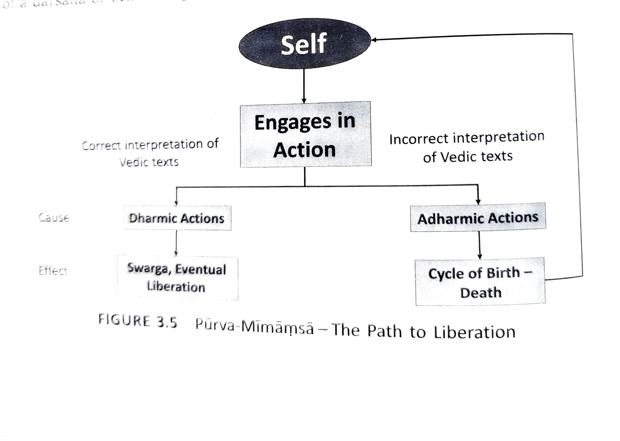

Slide 77
Vedanta (Uttara- mimamsa darsana)
The Vedanta school has established its tenets based on Jnana Kanda.
The Vedanta school rely on three major texts known as Prasthana- traya for establish their tenets.
This includes the Brahma-sutras written by Badrayana (Vyasa).

Slide 78
Following are the aspects of schools of Vedantas:
➢Advaita- Vedanta (reconizing what is one’s inherent nature)
➢Visistadvaita – Vedanta (combines the bhakti to the personal God and impersonal God as espoused in the Upanisads into a single school of thought)
➢Dvaita- Vedanta (that Visnu is the supreme God, the world is real and there is a difference between God and the Jivas.

Slide 79
Advaita - Vedanta - The Philosophy of Non-Dualism
Advaita Vedānta is one of the most influential schools of Indian philosophy, founded on the principle of non-dualism (Advaita)—the idea that there is only one ultimate reality, Brahman, and everything else is an illusion (Māyā).
It is primarily based on the Upaniṣads, the Bhagavad Gītā, and Brahma Sūtras, with its most prominent teacher being Ādi Śaṅkarācārya (8th century CE).

Slide 80
Key points
1. Brahman: The Ultimate Reality
Brahman is the formless, infinite, and changeless reality.
It is beyond name, form, attributes, and distinctions.
The Upaniṣads describe it as "Sat-Chit-Ānanda" (Existence-Consciousness-Bliss).
2. Jīva and Ātman: The Individual Self
The individual self (Jīva) is, in reality, Ātman, which is identical to Brahman.
Due to ignorance (Avidyā), the Jīva falsely perceives itself as separate.
3. Māyā: The Illusion of Duality
The world we experience is a projection of Māyā (illusion).
Māyā creates the false perception of duality (Dvaita), making us think we are separate from Brahman.

Slide 81
4. Jñāna Yoga: The Path to Liberation
The realization of Advaita comes through self-inquiry (Ātma-vichāra) and knowledge (Jñāna).
This is attained by studying the Upaniṣads, meditating on the Self, and removing ignorance.
5. Mokṣa: Liberation from Ignorance
When ignorance (Avidyā) is destroyed by true knowledge (Brahmavidyā), the Jīva realizes its oneness with Brahman.
This is Mokṣa—freedom from the cycle of birth and death (Samsāra).

Slide 82
Viśiṣṭādvaita Vedānta
Viśiṣṭādvaita Vedānta (विशिष्टाद्वैत वेदांत) is a school of Vedānta philosophy that means "Qualified Non-Dualism."
It was primarily developed by Rāmānuja (1017–1137 CE) and is based on the Upaniṣads, Bhagavad Gītā, and Brahma Sūtras.
Unlike Advaita Vedānta, which sees Brahman as the only reality and the world as an illusion (Māyā),
Viśiṣṭādvaita Vedānta teaches that Brahman is real, the world is real, and the individual souls are real

Slide 83
Dvaita Vedānta
Dvaita Vedānta (द्वैत वेदांत) is a school of Vedānta philosophy founded by Madhvācārya (1238–1317 CE).
It teaches strict dualism (Dvaita)—meaning that God (Brahman) and the individual souls (Jīvas) are eternally distinct and can never be the same.

Slide 84
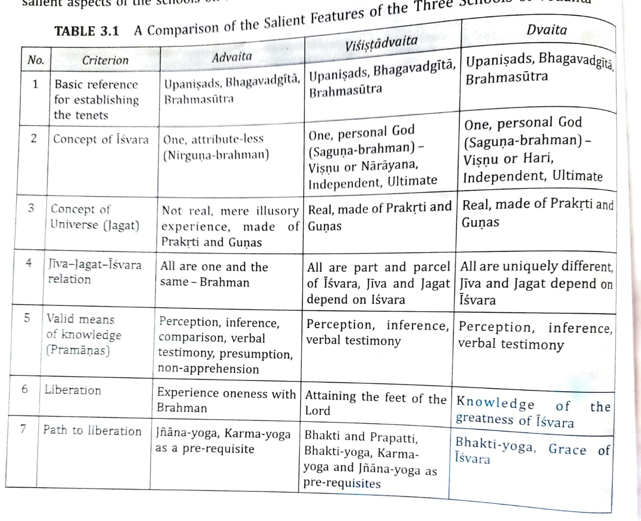

Slide 85
Non- Vedic Philosophical Systems
Jaina School of Philosophy
Buddha School of Philosophy
Carvaka School

Slide 86
Jaina School of Philosophy
The word Jaina is derived from the Sanskrit root “ji” to conquer essentially indicating someone who has successfully subdued his passions and obtained mastery.
The school considered 24 Thirthankaras from Vrsabhadeva to Mahavira.
In this, the cycle of birth-death is attributed tiny particles of matter that have embedded themselves into Jiva; this is called karma.
In the Jain philosophy, spiritual growth is to overcome this karma.

Slide 87
The Jain school of philosophy is one of the oldest Indian philosophical traditions, founded by Mahāvīra (599–527 BCE), the 24th Tīrthaṅkara.
Jainism is a non-theistic philosophy that emphasizes non-violence (Ahimsā), truth (Satya), and liberation (Mokṣa) through self-discipline and knowledge.
Unlike Hindu schools (Advaita, Viśiṣṭādvaita, Dvaita) that focus on Brahman (God), Jainism does not believe in a creator God.
Instead, it teaches that souls (Jīvas) are eternal and must attain liberation by their own efforts.

Slide 88
Buddha School of Philosophy
The Buddha School of Philosophy is largely based on the teaching of Gautama Buddha.
There are two forms of Buddhism:
  the northern form
  the southern form.
Buddha’s philosophy focuses on the means of ending the suffering of the individuals.
The four noble truths of Buddhism are:
  Suffering by clinging to 5 aggregates
  Thirst causes rebirth and suffering
  Cessation of suffering by destruction of desire
  8-fold path to end the suffering

Slide 89
Carvaka School
The Cārvāka school, also known as Lokāyata (Materialism), is one of the oldest nāstika (heterodox) schools of Indian philosophy.
It rejects the Vedas, God, karma, afterlife, and mokṣa, emphasizing only direct perception (pratyakṣa) and material pleasure as the highest goals of life.

Slide 90
Carvaka School
Carvaka School of thought closely maps to the trait of materialism which emphasizes a life of enjoyment based on certain principles and assumptions about life.
According to Carvaka school whatever is directly perceivable can only be accepted as valid means of knowledge.
No text of the Carvaka school is available to us today which discusses its tenets in totality.

Slide 91
Features of Carvaka School
Matter is ultimate reality
World is made of four basic elements (earth, water, fire, and air)
No room for any of the transcendental entities (beyond the physical world )
No afterlife, rebirth
Conclusions and knowledge are embodied, not eternal
Goal of life is experience pleasure ‘here and now’

Slide 92
Wisdom through the Ages
Stories provide a powerful medium through which one can impart education on a wide range of topics.
The genesis of this text provides interesting insights into the power of storytelling in bringing the accumulated wisdom to use.

Slide 93
Pañcatantra: A Treatise on Statecraft Through Stories
The Pañcatantra is an ancient Indian collection of fables and moral stories, traditionally attributed to Viṣṇuśarma.
He wrote the Pañcatantra to educate the dull-witted princes of a king, Amarśakti.
While it is often seen as a book of animal stories for children, it is actually a political and diplomatic treatise on statecraft (nīti-śāstra), teaching practical wisdom through storytelling.

Slide 94
Composed around 3rd century BCE – 3rd century CE in Sanskrit prose and verse.
Written as a manual for training young princes in the art of governance, diplomacy, and practical wisdom.
Uses animal allegories to explain complex political, social, and ethical concepts.
The main theme of Pañcatantra is Nīti (wise conduct and political strategy), which includes:
✔ Leadership skills
✔ Diplomacy and alliances
✔ Conflict resolution
✔ Psychological insights
✔ Practical wisdom for rulers

Slide 95
It is divided into five books (tantras), each focusing on different aspects of governance and human nature:
  Mitra-bheda (The Loss of Friends) : Lesson: Beware of cunning advisors and rumors.
  Mitra-lābha (Gaining Friends): Lesson: Unity and cooperation bring success.
  Kākolūkīyam (War and Peace / Crows and Owls): Lesson: Know your enemy, use intelligence over brute force.
  Aparīkṣitakāritam (Ill-considered Actions): Lesson: Think before you act.

Slide 96
Puranas- An Encyclopedic Work
Puranas are one of the most important literary sources of ancient and medieval Indian history and culture.
Puranas are companion texts to help understand and interpret the Vedas.
The study of Puranas and the Upapuranas are critical to developing an understanding of the social and religious institutions of India.
Puranas deals with the evolution of the universe, the recreation of the universe, genealogies of Gods and seers, and history of royal families.

Slide 97
Categories of Puranas
Maha- puranas
➢18 in number, about 400,00 verses
➢Cover a wide varity of topics
➢Has five laksanas
Upa- puranas
➢Several available
➢18 indentified as prominent
➢Smaller than Maha-Puranas
Sthala- puranas
➢Several of them available
➢Regional focus
➢All Languages (mainly in Sanskrit)

Slide 98
Issues of Interest in the Puranas
Puranas contain several discussions related to the plant kingdom and its role in addressing food, medicine and other requirements of society.
Several Puranas have discussions on astronomy, which consists of ideas in the pre-telescope age.
Issues of Interest:
  Food and Medicine
  Foetal Development: Stages of Growth
  Astronomy
  Geography

Slide 99
Food and Medicine
The Bhrahmavaivarta – purana mentions a balanced diet consisting of staple food, vegetables, and fruits that people used to take.
Based on the information available in the Agni, Matsya and Bhrahmavaivarta its inferred that rice, wheat, barley, pulses and sesame are common plants used for edible purposes
The uses of plants, herbs and shrubs is evident from the descriptions in the Agni – purana

Slide 100
Foetal Development: Stages of Growth
  The development of human embryo from the time of fertilization until the child is born has been well described in Bhagavata purana, Padma - purana

Slide 101
Astronomy
The movement of sun and the moon, day and night, months and seasons are basic ideas in astronomy
The also talk about stellar region, size of the planets and the other stars, which are mentioned in Puranas like Visnu, Matsya, Brahmanda, Vayu

Slide 102
Geography
Description of the origin of the Universe and the earth, oceans and continents, mountain
The puranas state that one of the seven regions is Jambu – dvipa where the Indian sub – continent (Bharata varsa) is situated.

